Slide 1




Presented by

Slide 2

Thingies in this presentation
Reservations
Cleaning
Other

Slide 3
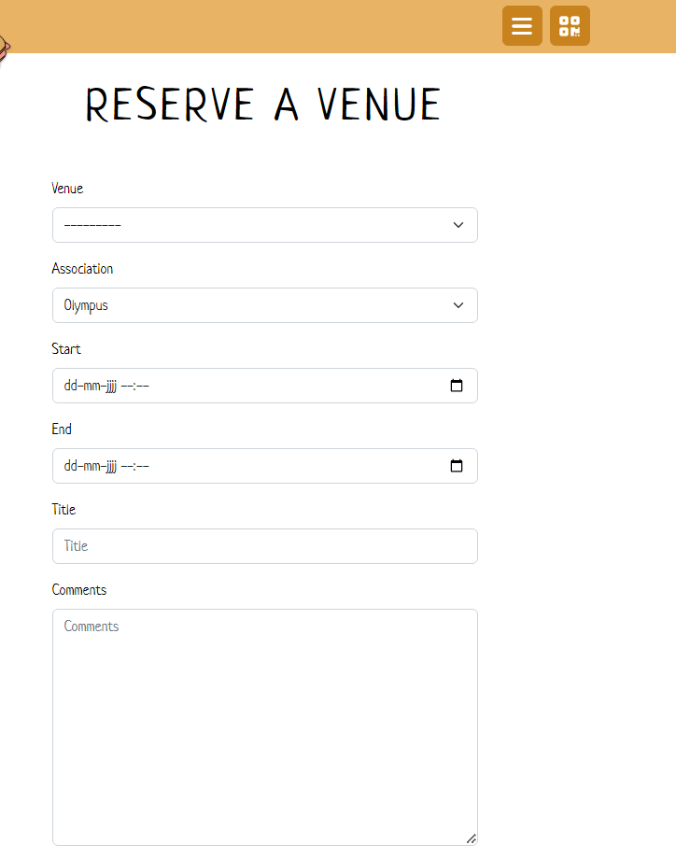
Reservations
Go to TOSTI.science.ru.nl
Go to venue reservation
Fill in the thingies
BIEM: canteen reserved
Reservations are accepted
by the Voorraadcie

Slide 4
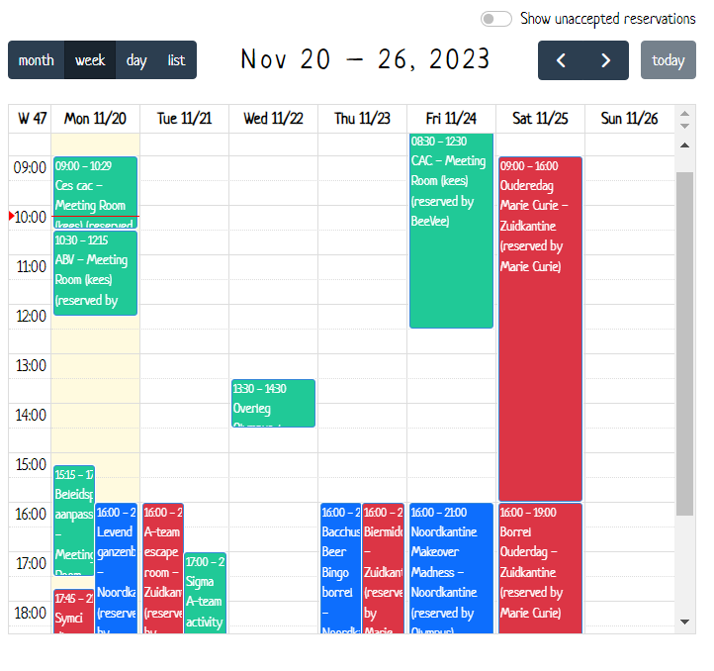
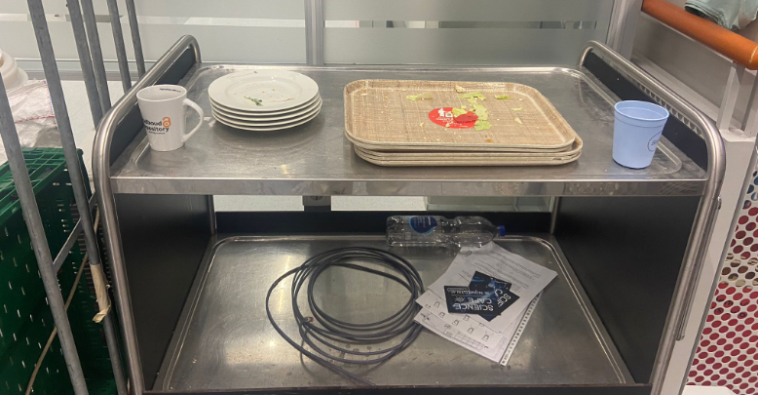
Cleaning rules
Rules have been revised and changed (a little)
Step-by-step:
  Check if you have to clean the canteen. Maybe there is an activity. You can see this in the TOSTI calendar.
  If there is an activity, congratulations, you don’t have to clean today.
  If you are North canteen board, you
  do have to bring the plates of the URD cart.

Slide 5
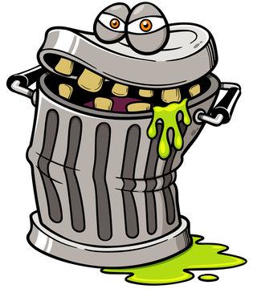

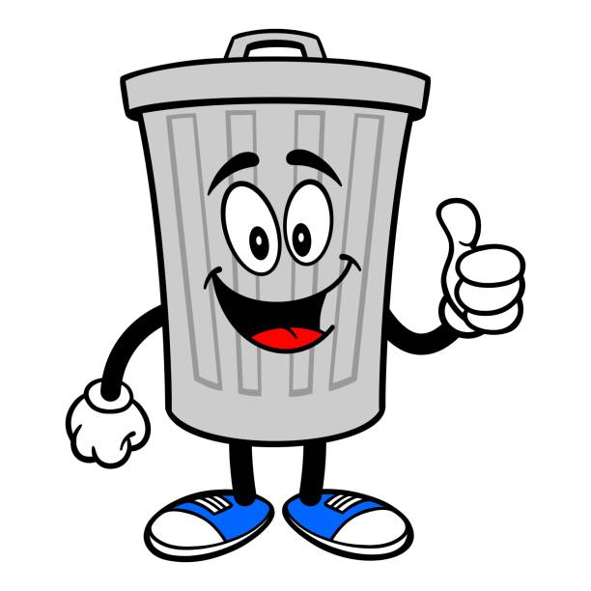
2. Close the windows
3. Throw away all of the garbage bags (if they are almost empty, you don’t have to do it, but otherwise you have to do it).
3.1 Bring the garbage bags to -2 and dump them in an appropriate container
3.2 If the garbage bags are almost empty, but there are flies or it smells or something, plz bring them to -2 as well.
4. Put in new bags in the cans (blue is rest, orange is plastic). If you don’t have enough garbage bags, plz contact me (Hazal), Mira or the Voorraadcie

Slide 6
5. Dishwasher shit
5.1 Empty the dishwasher if it is clean.
5.2 Put in the dirty mugs and other used glasses/stuff that have been left on the countertop
5.3 Turn on the dishwasher (there are dishwasher pods in the cabinet under the sink)
5.4 Make sure the bar is empty
6. Cleaning
6.1 Clean the countertop
6.2 Clean out the sink!!!!!
6.3 Clean the bar
6.4 Wipe the tables, chairs and couches

Slide 7
7. Last cleaning
7.1 Sweep the floor
7.2 Mop the floor if you deem this necessary. Also under the tables and the chairs. It is handiest if you put the chairs on the tables. After activities, mopping is definitely nice. :)
7.3 When you finish mopping, plz hang out the ‘mopkop’ where it can dry. If it is rlly gross, hang it out on the side of the laundry basket.
8. If there is no one left, turn the music off
8.1 In North, you can do this via TOSTI (it also closes itself at 9:30)
8.2 In South, you click on the middle mouse button

Slide 8
Other
If a mop or yellow doekje is used/gross, put it in the laundry basket (AH crate next to the entrance of the south canteen). If they are wet though, hang them out at the side of the laundry basket, or at the side of one of the buckets. Otherwise they’ll all become moldy and I have to buy new ones again :(
Don’t use the tosti irons, fridges and the freezer of the Tosticies. There is a fridge in the north board room for the purpose of activities.
If you want to put on posters in the canteen, you need schilderstape.
Plz put the dweilstokken/broom(s) against the wall or in a way that the hall way is empty enough to be used as a fire escape (otherwise IHZ will give me a’”slipper”)

Slide 9







Checking of the canteens will be done more routinely
So please make sure to clean the canteens properly. Otherwise, slipper!
No but seriously, it would be nice if we can keep the canteens clean together :)

